Slide 1
06 Nov 2023
Lecture:32

Slide 2
NP Completeness

Slide 3
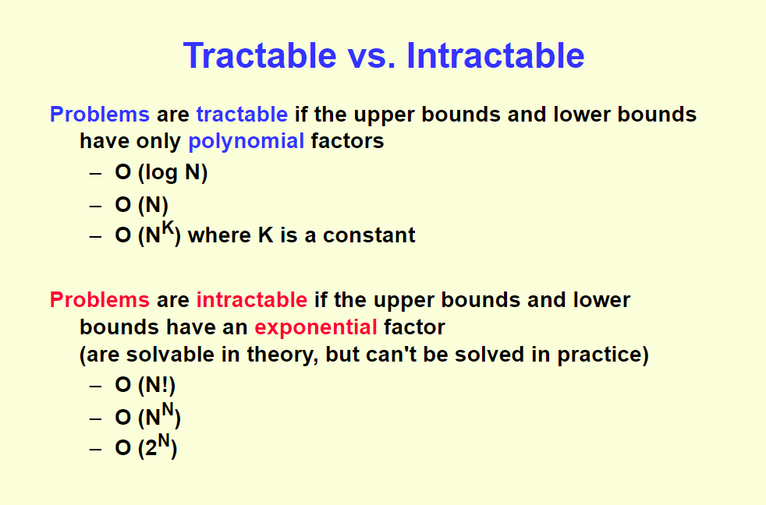

Slide 4
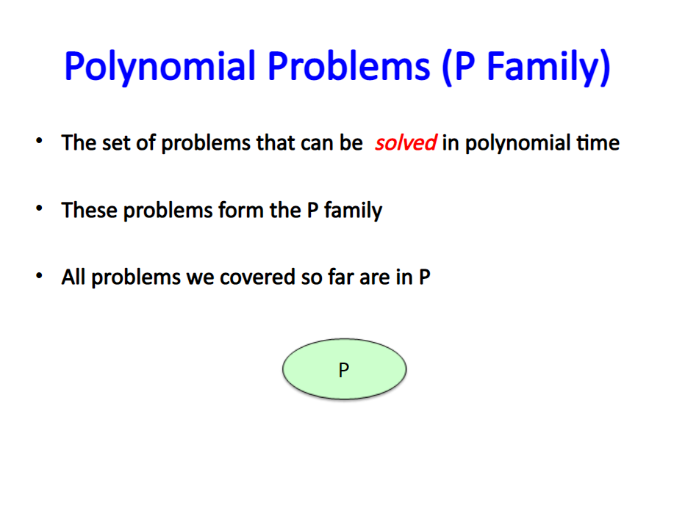

Slide 5
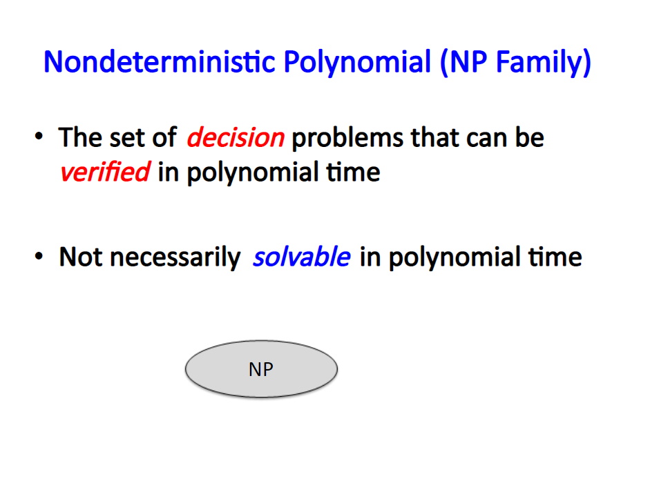

Slide 6
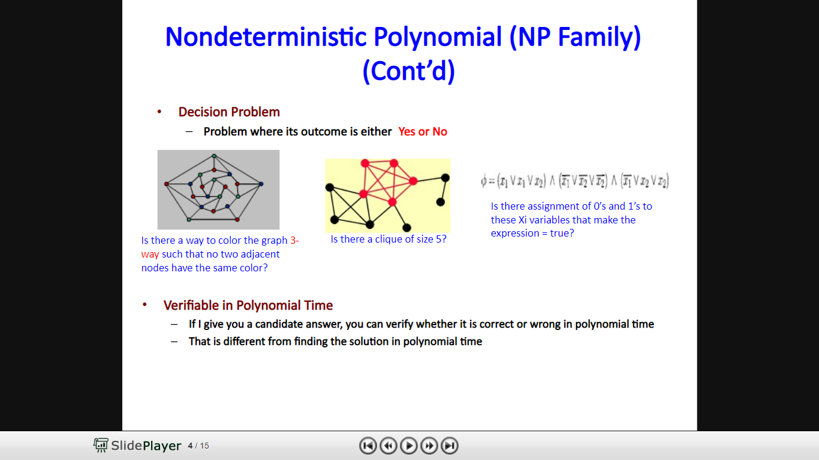

Slide 7
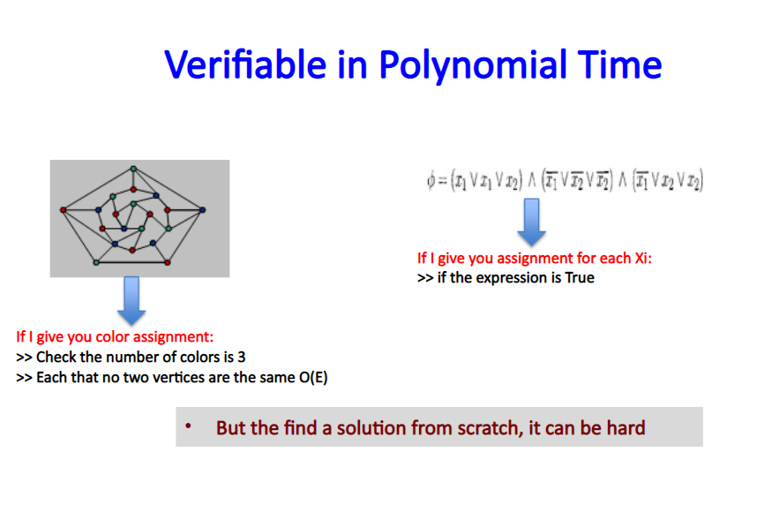

Slide 8
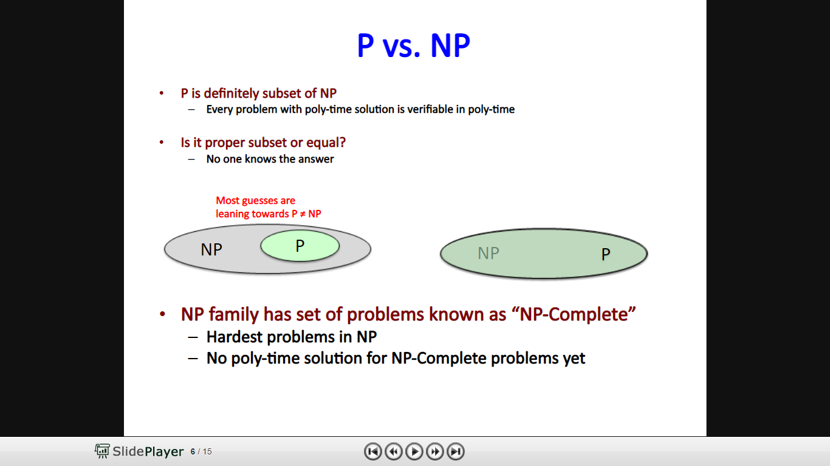

Slide 9
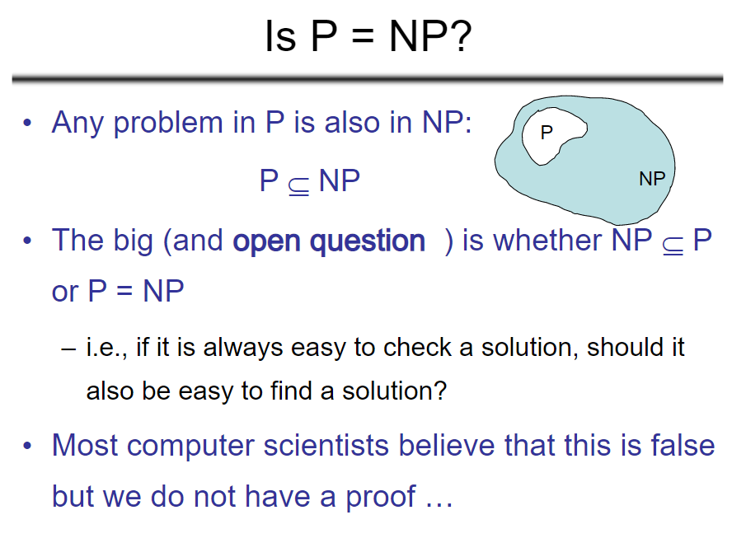

Slide 10
P=NP ?
One of the deepest questions in computer science is called P vs NP, and answering the question would earn you a million dollar prize.
P vs NP is one of the Clay Mathematics Institute Millennium Prize Problems, seven problems judged to be among the most important open questions in mathematics.

Slide 11
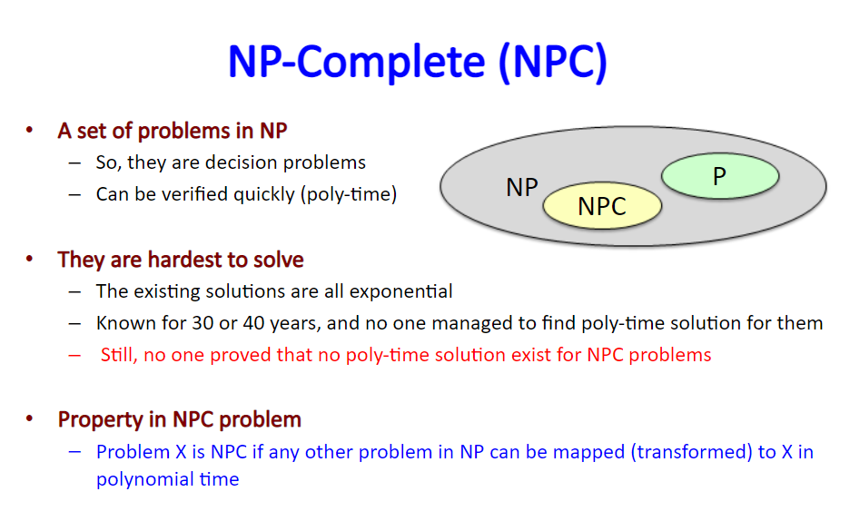

Slide 12
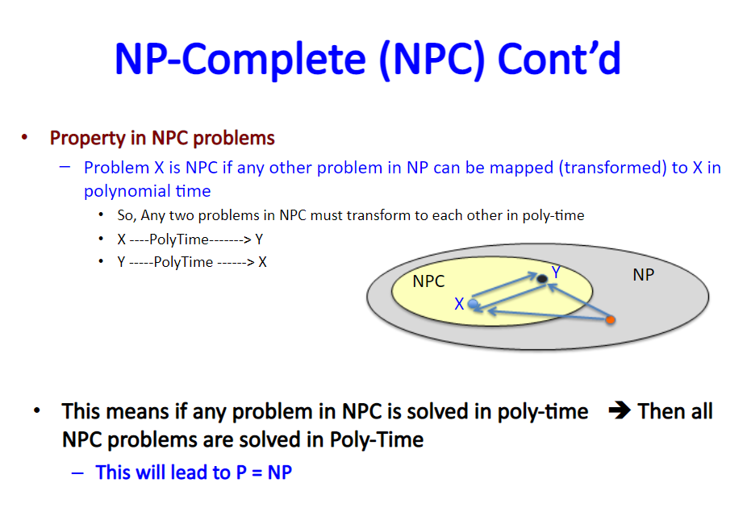

Slide 13
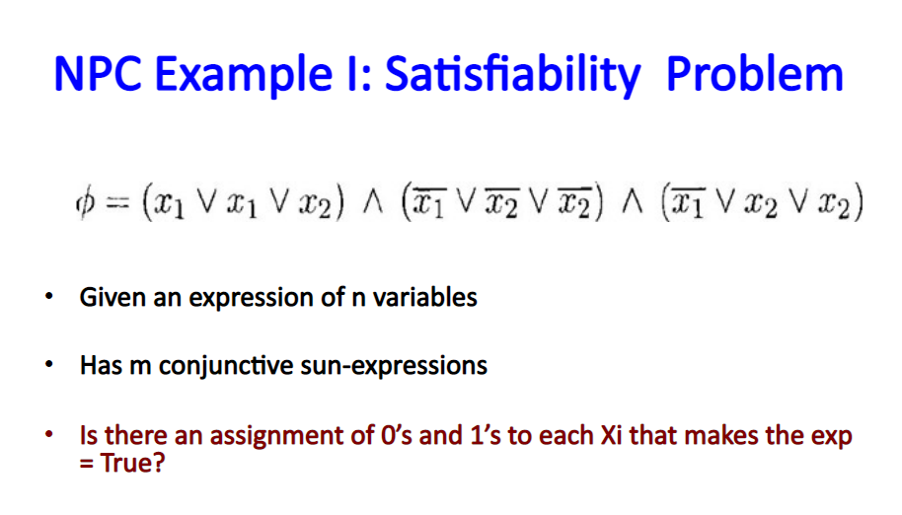

Slide 14
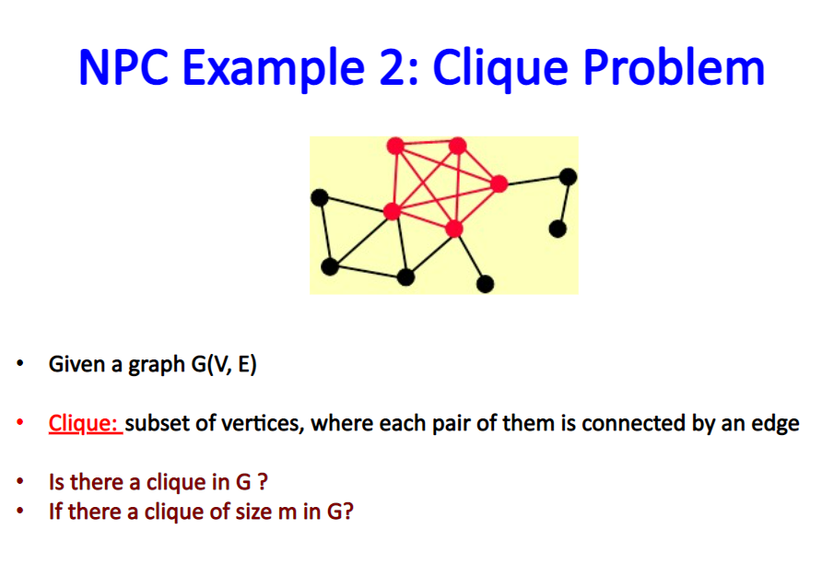

Slide 15
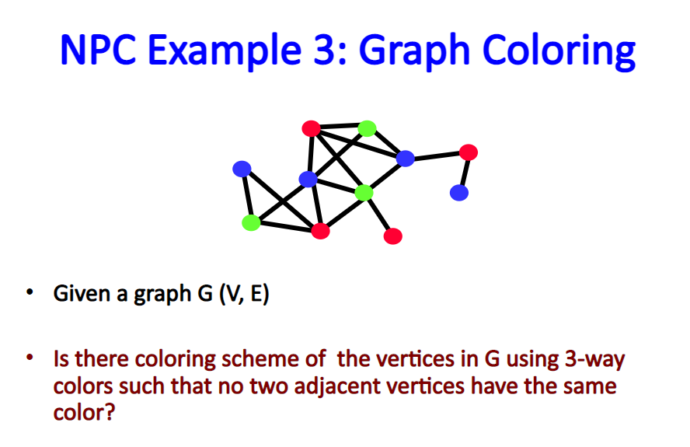

Slide 16
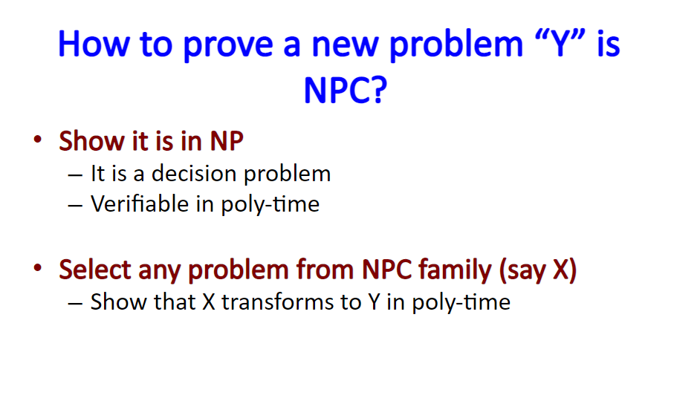

Slide 17
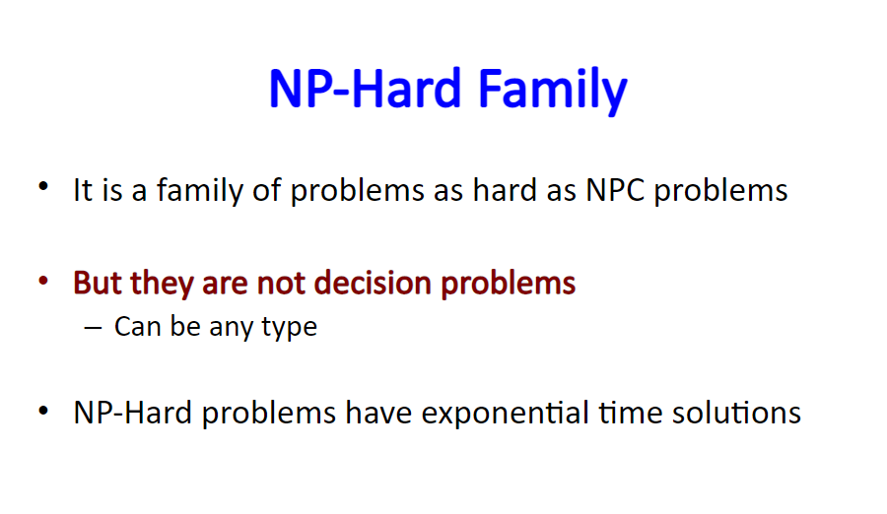

Slide 18
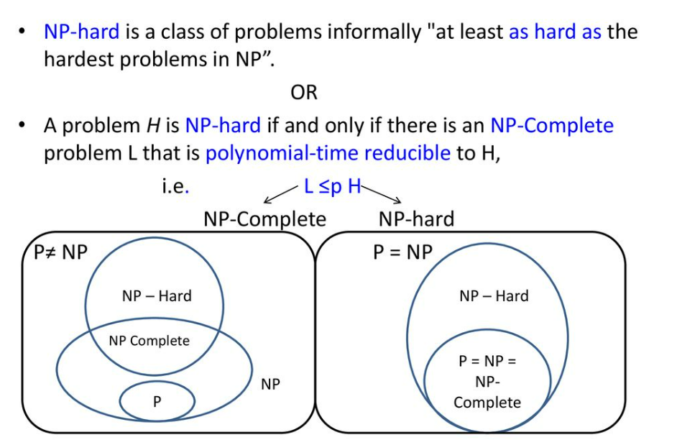

Slide 19
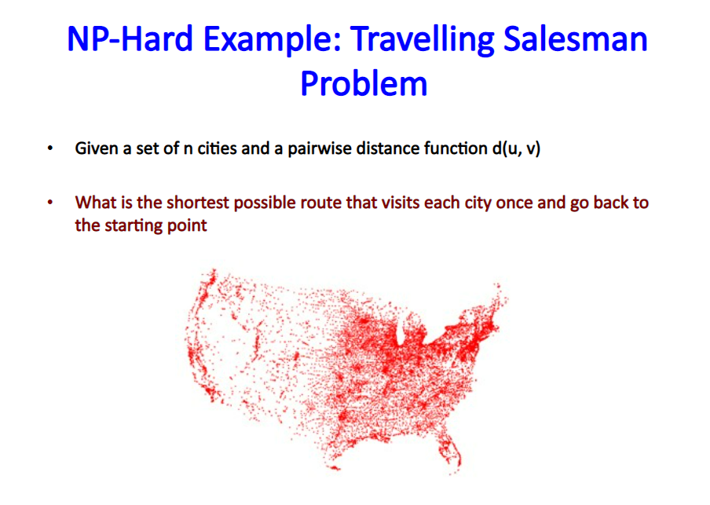

Slide 20
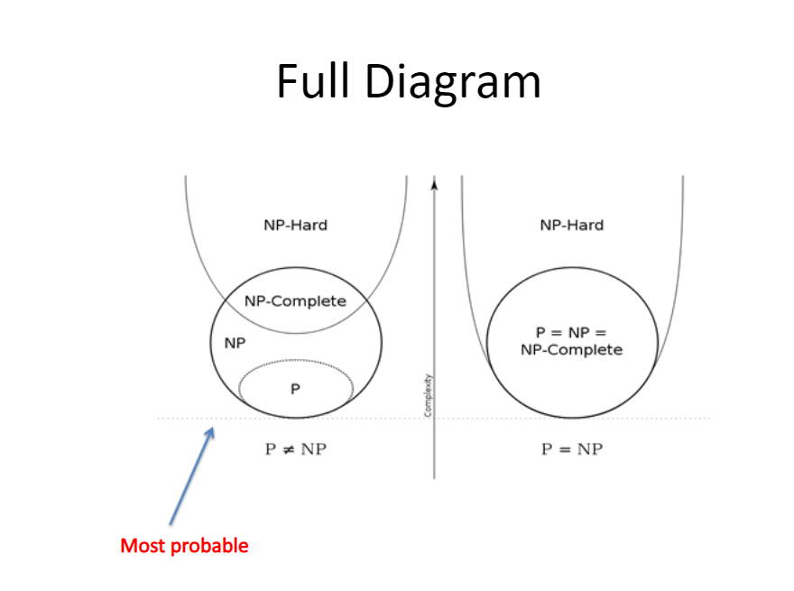

Slide 21
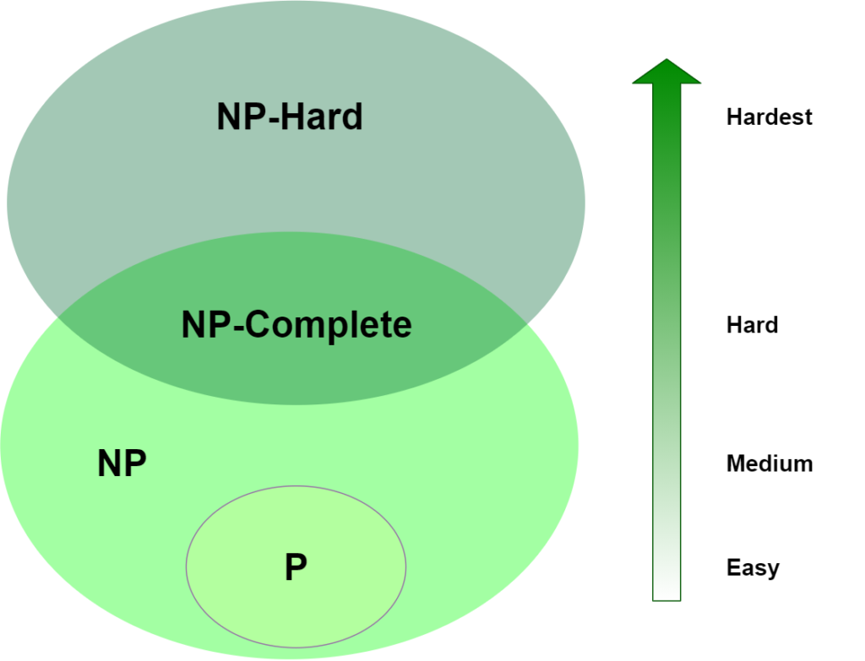

Slide 22
08 Nov 2023
Lecture:33

Slide 23
Approximation Algorithm

Slide 24
Approximation Algorithm
There is a strong evidence to support that No NP-Hard problems can be solved in polynomial time
Yet many NP-Hard problems have great practical importance and it is desirable to solve large instance of these problems in reasonable amount of time
The best known algorithm for NP-Hard problems have a worst case complexity that is exponential

Slide 25
Approximation Algorithm
NP-Hard problems
0/1 Knapsack Problem
Sum of Subset Problem
Maximum Size Clique Problem
TSP Problem
Etc….

Slide 26
Approximation Algorithm
Copying with NP-Hardness
1. Brute-Force Algorithms
2. Heuristics
3. Approximation Algorithms

Slide 27
Approximation Algorithm
Copying with NP-Hardness
Brute-Force Algorithm
Guaranteed to find optimal solution
NO guarantees on running time

Slide 28
Approximation Algorithm
Copying with NP-Hardness
Heuristics
Guaranteed to run in polynomial time.
No guarantees on quality of solution.

Slide 29
Approximation Algorithm
Copying with NP-Hardness
To produce an algorithm of low polynomial time complexity to solve NP-Hard problem it is necessary to relax the meaning of “SOLVE”
We remove the requirement that the algorithm that solves the optimization problem P must always generates optimal solution i.e. Algorithm for P must always generate the feasible solution

Slide 30
Approximation Algorithm
Def:
A feasible solution with a value close to optimal solution is known as Approximate Solution
Given an optimization problem P, an algorithm A is said to be an approximation algorithm for P, if for any given instance I, it returns an approximate solution, that is a feasible solution.

Slide 31
Approximation Algorithm
Copying with NP-Hardness
Approximation Algorithms
Guaranteed to run in polynomial time.
Guaranteed to get a solution which is close to the optimal solution (a.k.a near optimal).
Obstacle : need to prove a solution’s value is close to optimum value, without even knowing what the optimum value is !

Slide 32


Approximation Algorithm
C* = The Cost of optimal solution of the problem
C = The cost of solution using approximation algorithm
Maximization Problem
$$0<C≤C^{∗}$$
Approximation ratio = $\frac{C^{∗}}{C} ≥1$

Slide 33


Approximation Algorithm
C* = The Cost of optimal solution of the problem
C = The cost of solution using approximation algorithm
Minimization Problem
$0<C^{∗}≤$ $C$
Approximation ratio = $\frac{C}{C^{∗}} ≥1$

Slide 34

Approximation Algorithm
In general
Approximation ratio = max { $\frac{C}{C^{∗}}$, $\frac{C^{∗}}{C}$}
As Approximation ratio $≥1$

Slide 35
Approximation Algorithm
Symmetric TSP
A TSP where C_{ij}=C_{ji}
Metric TSP:
A TSP which satisfy triangle inequality
Helps to take Shortcuts
a + b > c
a
b
a + c > b
b + c > a
c

Slide 36
TSP
Double Tree Algorithm:
Find The Minimum Spanning Tree T
Duplicate the edges of T
Find Eulerian Tour
Shortcut the Eulerian tour

Slide 37
TSP
A
A
100
85
66
66
30
C
MST
C
B
20
D
20
30
B
D
101
65
65
110
E
E

Slide 38
TSP
A
Euler Tour
66
66
A, D
20
30
C
B
D
30
20
65
65
E

Slide 39
TSP
A
Euler Tour
66
66
A, D, C
20
30
C
B
D
30
20
65
65
E

Slide 40
TSP
A
Euler Tour
66
66
A, D, C, D
20
30
C
B
D
30
20
65
65
E

Slide 41
TSP
A
Euler Tour
66
66
A, D, C, D, E
20
30
C
B
D
30
20
65
65
E

Slide 42
TSP
A
Euler Tour
66
66
A, D, C, D, E, D
20
30
C
B
D
30
20
65
65
E

Slide 43
TSP
A
Euler Tour
66
66
A, D, C, D, E, D, B
20
30
C
B
D
30
20
65
65
E

Slide 44
TSP
A
Euler Tour
66
66
A, D, C, D, E, D, B, D
20
30
C
B
D
30
20
65
65
E

Slide 45
TSP
A
Euler Tour
66
66
A, D, C, D, E, D, B, D, A
20
30
C
B
D
30
20
65
65
E

Slide 46
TSP
A
Euler Tour
A, D, C, D, E, D, B, D, A
66
66
20
30
C
Take the Shortcuts
B
D
30
A, D, C, D, E, D, B, D, A
20
65
65
E

Slide 47
TSP
A
Euler Tour
A, D, C, D, E, D, B, D, A
66
66
20
30
C
Take the Shortcuts
B
D
20
30
A, D, C, D, E, D, B, D, A
65
65
E

Slide 48
TSP
A
Euler Tour
A, D, C, D, E, D, B, D, A
66
66
20
30
C
Take the Shortcuts
B
D
30
A, D, C, D, E, D, B, D, A
20
65
65
A, D, C, E, B, A
E

Slide 49
TSP
A
A, D, C, E, B, A
100
85
66
The Tour Cost = 66 + 30 + 110 + 101 + 100
= 407
30
C
B
20
D
101
65
110
E
NOTE: Double Tree Algorithm is a 2-factor
approximation algorithm

Slide 50

Quiz-12

Slide 51
10 Nov 2023
Lecture:34

Slide 52
Computational Geometry: Convex Hull

Slide 53

Computational Geometry: Convex Hull
We want to surround the following set of trees by as less fence as possible

Slide 54
Computational Geometry: Convex Hull
Convex Hull

Slide 55


Computational Geometry: Convex Hull
Convex Set: A set S is convex set if for any two points p and q $∈S$the line segment joining p and q $⊂$ S
p
p
q
q

Slide 56










Computational Geometry: Convex Hull
Convex Set: A set S is convex if It an intersection of half spaces

Slide 57

Computational Geometry: Convex Hull
Convex Hull: Given a finite set of points P = {p₁, p₂, p₃,……p_{n}} the the convex hull of P is the smallest convex set C such that $P ⊂$ S

Slide 58





Computational Geometry: Convex Hull
Observation: Each interior angle of convex hull is $≤180o$
$$≤180o$$
$$≤180o$$
$$≤180o$$
$$≤180o$$
$$≤180o$$

Slide 59
Convex Hull Problem
Given: A finite set of points P = {p₀, p₁, p₂, …………….p_{n}} is given
Goal: Find a Convex Hull for P

Slide 60
Computational Geometry: Convex Hull
Approaches
Jarvis March Algorithm
Graham Scan Algorithm
Assumption: No three points are collinear

Slide 61
Computational Geometry: Convex Hull
Jarvis March Algorithm or Gift Wrapping Algorithm
Select the point with lowest Y-coordinate(bottom most point) – First point
Select the points with smallest counter-clock wise in reference to the previous point
Repeat util reaching the starting point

Slide 62
Jarvis March Algorithm or Gift Wrapping Algorithm

Slide 63
Jarvis March Algorithm or Gift Wrapping Algorithm
Starting Vertex

Slide 64
Jarvis March Algorithm or Gift Wrapping Algorithm
Horizontal Line
Starting Vertex

Slide 65
Jarvis March Algorithm or Gift Wrapping Algorithm
Starting Vertex

Slide 66
Jarvis March Algorithm or Gift Wrapping Algorithm
Starting Vertex

Slide 67
Jarvis March Algorithm or Gift Wrapping Algorithm
Starting Vertex

Slide 68
Jarvis March Algorithm or Gift Wrapping Algorithm
Starting Vertex

Slide 69
Jarvis March Algorithm or Gift Wrapping Algorithm
Starting Vertex

Slide 70
Jarvis March Algorithm or Gift Wrapping Algorithm
Starting Vertex

Slide 71
Jarvis March Algorithm or Gift Wrapping Algorithm
Starting Vertex

Slide 72
Jarvis March Algorithm or Gift Wrapping Algorithm
Starting Vertex

Slide 73
Jarvis March Algorithm or Gift Wrapping Algorithm
Starting Vertex

Slide 74
Jarvis March Algorithm or Gift Wrapping Algorithm
Starting Vertex

Slide 75
Jarvis March Algorithm or Gift Wrapping Algorithm
Starting Vertex

Slide 76
Jarvis March Algorithm or Gift Wrapping Algorithm
Convex Hull
Starting Vertex

Slide 77
Jarvis March Algorithm or Gift Wrapping Algorithm
Time Complexity =O(nh)
Where
n: the number of points in set
p: the number of points on convex hull

Slide 78
20 Nov 2023
Lecture:35

Slide 79
Graham Scan Algorithm
Select the point with lowest Y coordinate (bottom most point)
Sorts the remaining points by the angle relative to the bottom most point and the horizontal
Iterate in sorted order, placing each point on the stack but only if it makes a counter clockwise turn relative to the previous 2 points on the stack
Pop previous point off the stack if making a clock wise turn

Slide 80
Graham Scan Algorithm

Slide 81
Graham Scan Algorithm
Starting Vertex

Slide 82
Graham Scan Algorithm
4
5
3
2
7
6
1
8
0

Slide 83
Graham Scan Algorithm
4
1
0
5
3
2
7
6
1
8
Stack
0

Slide 84
Graham Scan Algorithm
4
1
0
5
3
2
7
6
1
8
Stack
0

Slide 85
Graham Scan Algorithm
4
2
1
0
5
3
2
7
6
1
8
Stack
0

Slide 86
Graham Scan Algorithm
4
2
1
0
5
3
2
7
6
1
8
Stack
0

Slide 87
Graham Scan Algorithm
4
3
2
1
0
5
3
2
7
6
1
8
Stack
0

Slide 88
Graham Scan Algorithm
4
3
2
1
0
5
3
2
7
6
1
8
Stack
0

Slide 89
Graham Scan Algorithm
4
2
1
0
5
3
2
7
6
1
8
Stack
0

Slide 90
Graham Scan Algorithm
4
2
1
0
5
3
2
7
6
1
8
Stack
0

Slide 91
Graham Scan Algorithm
4
4
2
1
0
5
3
2
7
6
1
8
Stack
0

Slide 92
Graham Scan Algorithm
4
4
2
1
0
5
3
2
7
6
1
8
Stack
0

Slide 93
Graham Scan Algorithm
4
5
4
2
1
0
5
3
2
7
6
1
8
Stack
0

Slide 94
Graham Scan Algorithm
4
5
4
2
1
0
5
3
2
7
6
1
8
Stack
0

Slide 95
Graham Scan Algorithm
4
6
5
4
2
1
0
5
3
2
7
6
1
8
Stack
0

Slide 96
Graham Scan Algorithm
4
6
5
4
2
1
0
5
3
2
7
6
1
8
Stack
0

Slide 97
Graham Scan Algorithm
4
5
4
2
1
0
5
3
2
7
6
1
8
Stack
0

Slide 98
Graham Scan Algorithm
4
4
2
1
0
5
3
2
7
6
1
8
Stack
0

Slide 99
Graham Scan Algorithm
4
7
4
2
1
0
5
3
2
7
6
1
8
Stack
0

Slide 100
Graham Scan Algorithm
4
7
4
2
1
0
5
3
2
7
6
1
8
Stack
0

Slide 101
Graham Scan Algorithm
4
8
7
4
2
1
0
5
3
2
7
6
1
8
Stack
0

Slide 102
Graham Scan Algorithm
4
8
7
4
2
1
0
5
3
2
7
6
1
8
Stack
0

Slide 103
Graham Scan Algorithm
4
5
3
2
7
6
1
8
Convex Hull
0

Slide 104
Graham Scan Algorithm
Time Complexity = O(nlogn)

Slide 105

Quiz-13

Slide 106

Quiz-14

Slide 107

Quiz-15

Slide 108
Randomized Algorithm
Deterministic Vs Randomized Algorithm
Why randomization
Las Vegas Algorithm
Monte-Carlo Algorithm
Randomized Quick Sort

Slide 109
Randomized Algorithm
Deterministic Algorithm: An algorithm for which if we fix the input the output and running time is also fixed
Deterministic Algorithm
INPUT
OUTPUT

Slide 110
Randomized Algorithm
Randomized Algorithm: An algorithm which takes input and a random number(a sequence of random bits) and if we fix the i/p the corresponding o/p and running time will vary
Randomized Algorithm
INPUT
OUTPUT
Random Number

Slide 111
Randomized Algorithm
Randomized Algorithm: if we fix the i/p the corresponding o/p and running time will vary
Randomized Algorithm
INPUT
OUTPUT
Random Number

Slide 112
Randomized Algorithm
Inside the logic of randomized algorithm, it uses random integers to decide what to do next
Randomized Algorithm uses randomness as a computing tool for algorithm design
Randomized Algorithms are also called Probabilistic Algorithms.

Slide 113
Randomized Algorithm
Randomized Algorithm uses randomness as a computing tool for algorithm design

Slide 114
Randomized Algorithm
Problem: Finding an element x from a list A of n number
Randomized_Search:
Repeat
i ← random_number(0,n-1)
if x == A[i]
return i
Until(x is NOT found)

Slide 115
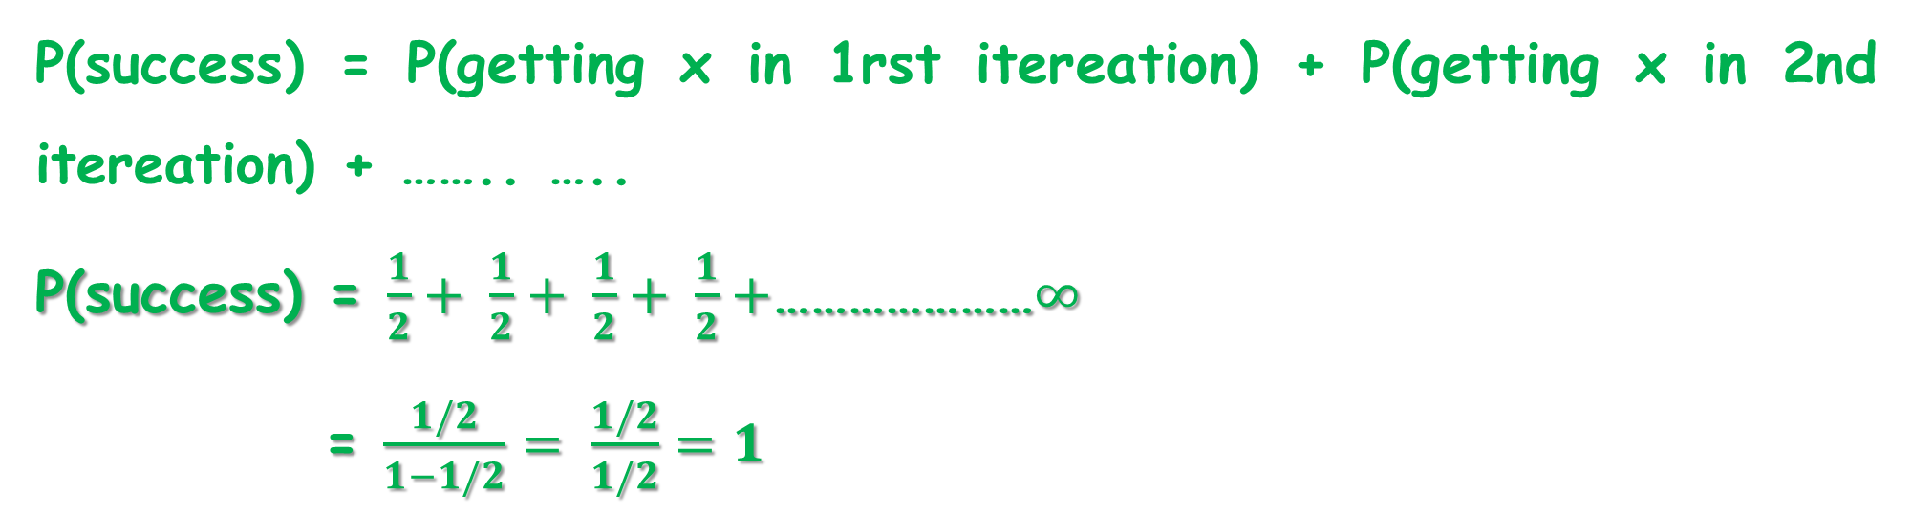
Randomized Algorithm
Problem: Finding an element x from a list A of n number
P(success) = P(getting x in 1rst itereation) + P(getting x in 2nd itereation) + …….. …..
P(success) = $\frac{1}{2}+ \frac{1}{2}+$ $\frac{1}{2}+$ $\frac{1}{2}+$…………………$∞$
= $\frac{1/2}{1−1/2}= \frac{1/2}{1/2}=1$

Slide 116
Randomized Algorithm
Advantages
Randomness often helps in significant reduction of work involved in finding correct Solution
Simplicity : Simple in nature. Uses pseudo random number generator
Very Efficient : These algorithms are efficient as compared to deterministic algorithms. Deterministic Algorithms take a long time whereas Randomized Algorithms take less time to run.

Slide 117
Randomized Algorithm
Disadvantages
Loss of confidence in correctness of solution
Note:
This loss can be reduced by repeated application of randomized algorithm

Slide 118
Randomized Algorithm
Types of Randomized Algorithm
Lass-Vegas Algorithm
Monte-Carlo Algorithm

Slide 119
Randomized Algorithm
Las Vegas Algorithm
Monte Carlo Algorithm
It always produces correct solution
Time is not fixed for the same input (Gambling with time)
It may or may not produce the correct solution
It runs for finite no. of iteration(Gambling with the correctness of solution)

Slide 120
Randomized Algorithm
Randomized_Search:
Repeat
i ← random_number(0,n-1)
if x == A[i]
return i
Until(x is NOT found)
LAS-VEGAS Algorithm

Slide 121
Randomized Algorithm
Randomized_Search:
Repeat 400 times
i ← random_number(0,n-1)
if x == A[i]
return i
Rturn “fail”
MONTE-CARLO Algorithm

Slide 122
22Nov 2023
Lecture:36

Slide 123
Randomized Quick Sort
Pivot in each partition is selected Randomly

Slide 124
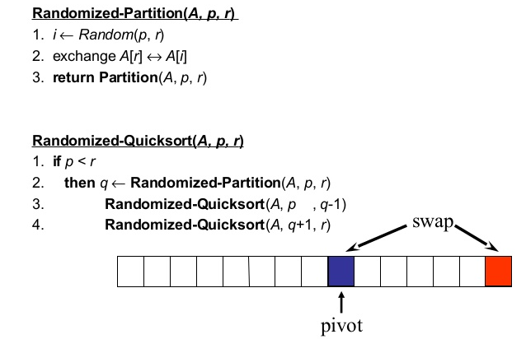
Randomized Quick Sort

Slide 125
Randomized Quick Sort
Average Cost = O(nlogn)
Worst Cost = O(n²)
Less Likelihood

Slide 126
ONLINE ALGORITHM

Slide 127
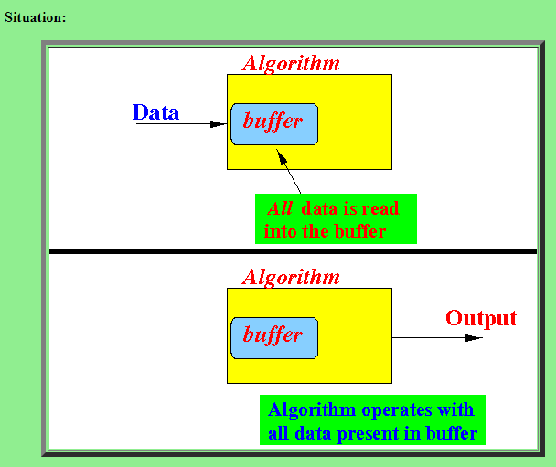
Offline Algorithm
Offline algorithm is an algorithm whose input data is given to the algorithm when the algorithm begins to execute

Slide 128
Offline Algorithm
Any sorting algorithm
The data of a sorting algorithm is given in an input file and it is usually read into an array
When the sorting algorithm begins, all input data is available in the array

Slide 129
Online Algorithm
An online algorithm is an algorithm that can process its input piece-by-piece in a serial fashion.
The algorithm processes the input data as they come in, without having the entire input available from the start.

Slide 130
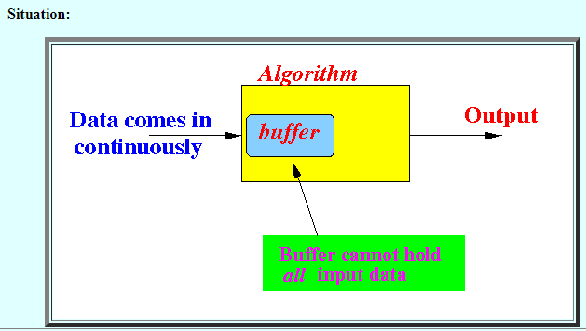
Online Algorithm

Slide 131
Online Algorithm

Slide 132
Online Algorithm
Insertion Sort
Greedy Algorithm

Slide 133
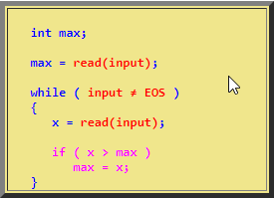
Online Algorithm
Computing maximum value in an input stream

Slide 134
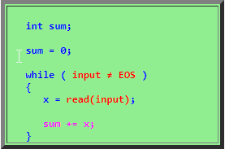
Online Algorithm
Computing the sum of the value in an input stream:

Slide 135
Online Algorithm
Challenges of designing online algorithms:
Uncertainty:
Online algorithms must make decisions without knowing all of the input data. This can make it difficult to choose the best course of action.

Slide 136
Online Algorithm
Challenges of designing online algorithms:
Adaptability:
Online algorithms must be able to adapt to changing input patterns. For example, an online caching algorithm must be able to adapt to changes in user access patterns.

Slide 137
Online Algorithm
Challenges of designing online algorithms:
Efficiency:
Online algorithms must be efficient, as they are often used in real-time applications. This means that they must make decisions quickly and use limited resources.

Slide 138
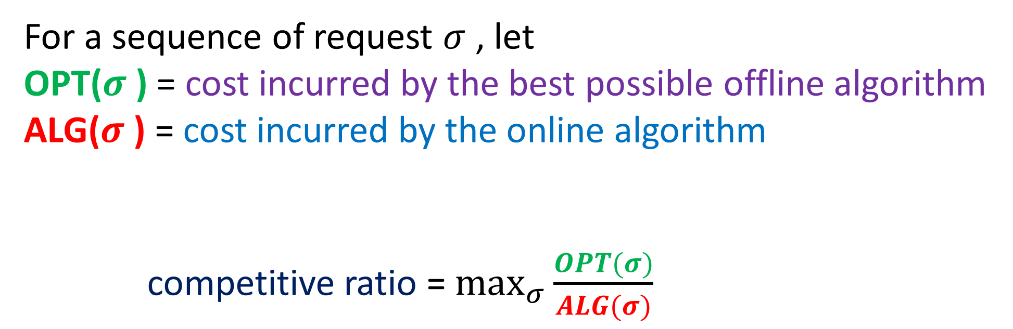
Online Algorithm
For a sequence of request $σ$ , let
OPT($σ$ ) = cost incurred by the best possible offline algorithm
ALG($σ$ ) = cost incurred by the online algorithm
competitive ratio = $\max_{σ}{\frac{OPT(σ)}{ALG(σ)}}$

Slide 139
Online Algorithm
Best choice problem
You are allowed to take only one from a bag of diamonds, with different sizes that you do not know.
Each time a diamond is randomly taken from the bag and shown to you.
You now need to decide to take it or reject it.
If you take it the game stops; otherwise, the diamond is put away and a new one is taken from the bag.
You cannot go back to take a diamond that has been put away.

Slide 140
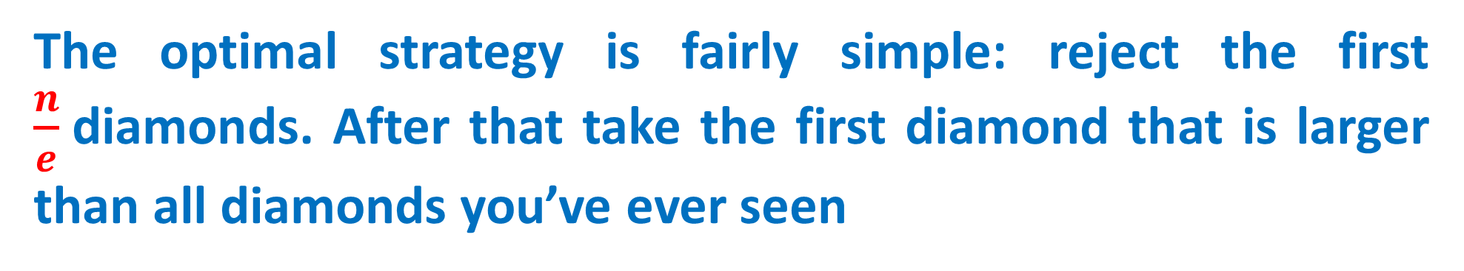
Online Algorithm
What’s your best strategy to maximize the probability of getting the largest diamond?
The optimal strategy is fairly simple: reject the first $\frac{n}{e}$diamonds. After that take the first diamond that is larger than all diamonds you’ve ever seen

Slide 141
Online Algorithm
Also known as
Secretary Problem
marriage problem

Slide 142
K-Server Problem
A metric d on a set X is a function d : X × X → R such that for all x, y ∈ X:
d(x, y) ≥ 0 and d(x, y) = 0 if and only if x = y
d(x, y) = d(y, x) (symmetry)
d(x, y) ≤ d(x, z) + d(z, x) (triangle inequality)
A metric space (X, d) is a set X with a metric d defined on X.

Slide 143
K-Server Problem
k > 1 servers
M is a metric space with metric d
Servers are located at points of M
Request sequence σ consists of points of M
A request is served by moving a server there
Cost is total distance traveled by servers
Goal: minimize the total cost

Slide 144

2-Server Problem
K=2
Raju
Kaju
DELHI
C-1
GURUGRAM
NOIDA
C-3
Technician = Servers
C-2

Slide 145
2-Server Problem
K=2
Raju
DELHI
C-1(W)
100 km
GURUGRAM
C-3(SF)
40 km
Kaju
NOIDA
100 km
Technician = Servers
C-2(B)

Slide 146
2-Server Problem
DELHI
Raju
Kaju
C-1(W)
100 km
GURUGRAM
C-3(SF)
40km
NOIDA
100 km
C-2(B)

Slide 147
2-Server Problem
Scenario: Always assigns the closest server
Suppose that for 100 days
Each day in the morning the customer in Delhi needs assistance
Each day in the afternoon the customer in Noida needs assistance,
The customer in Gurugram never needs assistance

Slide 148
2-Server Problem
DELHI
Raju
Kaju
C-1(W)
100 km
GURUGRAM
C-3(SF)
40 km
NOIDA
100 km
C-2(B)

Slide 149
2-Server Problem
Raju
DELHI
Kaju
C-1(W)
100 km
GURUGRAM
C-3(SF)
40 km
NOIDA
100 km
C-2(B)

Slide 150
2-Server Problem
DELHI
Kaju
C-1(W)
100 km
GURUGRAM
C-3(SF)
40 km
NOIDA
100 km
C-2(B)
Raju

Slide 151
2-Server Problem
Total distance travelled = 100 + 100 x 80
= 8100 km

Slide 152
2-Server Problem
Better Approach
Raju
DELHI
C-1(W)
100 km
GURUGRAM
C-3(SF)
40 km
Kaju
NOIDA
100 km
C-2(B)

Slide 153
2-Server Problem
Total Cost = 100 + 100 = 200 km < 8100 km
we see that always assigning the closest server can be far from optimal

Slide 154
2-Server Problem
it seems foolish for an algorithm that does not know future requests to send both of its technicians away from Gurugram
As the next request could be in that city and it would have to send someone back immediately.

Slide 155
2-Server Problem
It seems that it is difficult or impossible for a k-server algorithm to perform well relative to its adversary
For the 2-server problem, there exists an algorithm that always has a total travel distance of at most twice the adversary's distance

Slide 156
2-Server Problem
The k-server problem is NP-hard, and finding an optimal solution is computationally expensive

Slide 157
k-Server Problem
Notable Algorithms:
Greedy Algorithm:
The Greedy algorithm moves the closest server to the requested point.
Move to the Middle:
This algorithm keeps the servers evenly spaced among the active requests.
Work Function Algorithm:
This approach maintains a "work function" that represents the total cost of serving all previous requests. It dynamically adjusts server positions to minimize this function.

Slide 158
k-Server Problem
Application:
Online Caching
Network Design
Robot Motion Planning
Resource Allocation in Cloud Computing
Dynamic Load Balancing
Vehicle Routing and Fleet Management
Sensor Networks
Mobile Communication Networks

Slide 159

Quiz-16

